Slide 1
Network Routing Optimization
Franklin Sintic & Miller Kites

Slide 2

Introduction to the Problem
The Network Routing Optimization problem is essentially determining the most efficient path for data whilst minimizing cost and delay.
This is be represented by graphs and graph traversal algorithms.

Slide 3
Project Scope and Goals
Implement at least 3 standard algorithms.
Implements at least 1 nature-inspired algorithm.
Compare runtime and efficiency between them with either -
Synthetic Graphs
OpenStreetMaps – The Goal with this is to provide a "real-life" example

Slide 4

Dijkstra & Bellman-Ford Algorithms
Dijkstra's Algorithm:
Calculates the minimum cost from a source node to every other node in the graph.
We can adjust this to make it print the shortest path to our desired node
Bellman-Ford Algorithm:
Functions the same as Dijkstra, however it is able to compute negative weights.
We didn’t add any negative weights in testing or data collection.

Slide 5
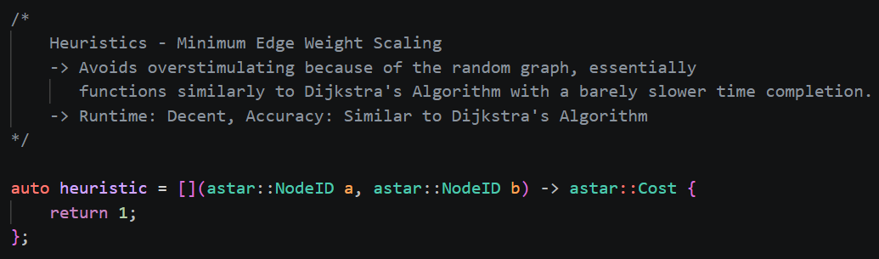
A* Algorithm
A* Algorithm:
Finds shortest path from one node to another.
It does not search through the nodes like Dijkstra, instead uses a heurstic.
f(n) = g(n)+h(n)
g(n) = total path cost from start
h(n) = cost remaining to get to target
Heuristics Options in Code:
Return 1: Slight guidance, follows Dijkstra
Return 0: Exactly like Dijkstra

Slide 6
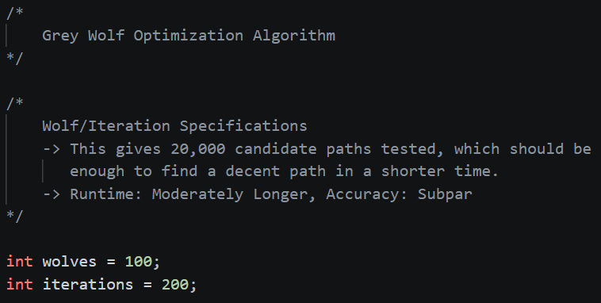
GWO Algorithm
Grey Wolf Algorithm simulates a wolf pack. In code, it generates as many solutions and keeps the best one found.
Over iterations, each wolf generated a random path from one node to another. After comparison, that was set as the best path.
Included for inclusion of a nature-inspired algorithm and to compare the 2 heurstic algorithms.

Slide 7
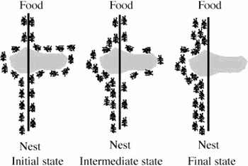
ACO Algorithm
The Ant Colony Optimization algorithm takes an approach to how ants leave pheromones to certain paths they take to food.
In code, after many ants use a path, it leaves a "pheromone strength", which will make it the higher priority path – future ants will take this path.
Over iterations, one path gets highlighted with the pheromones.

Slide 8
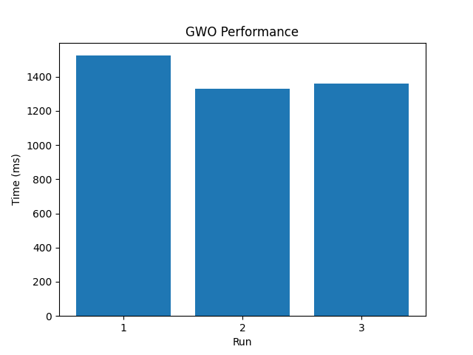
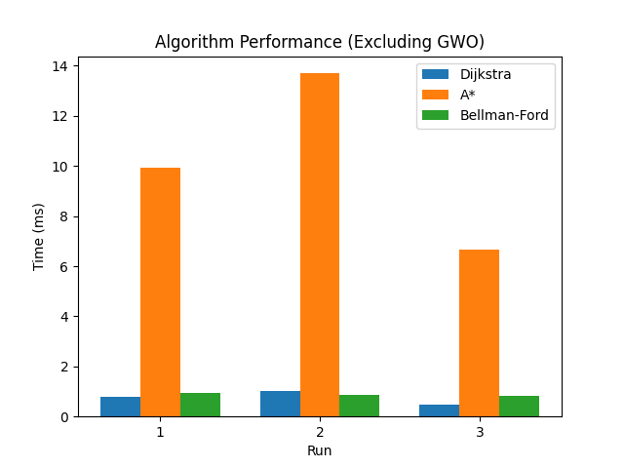
Small Size Runtime

Slide 9
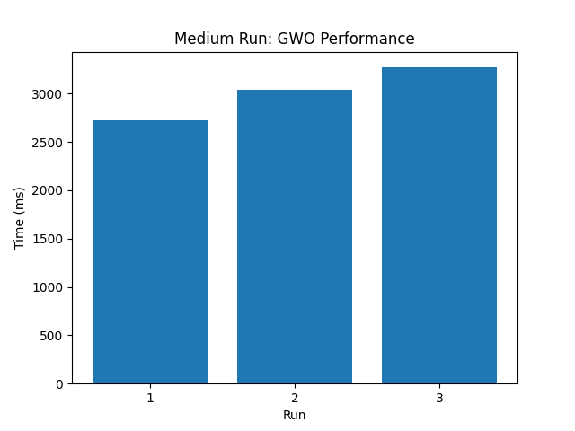
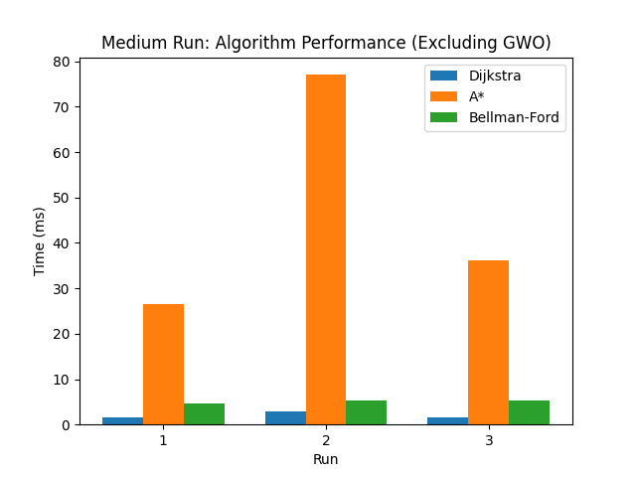
Medium Size Runtime

Slide 10
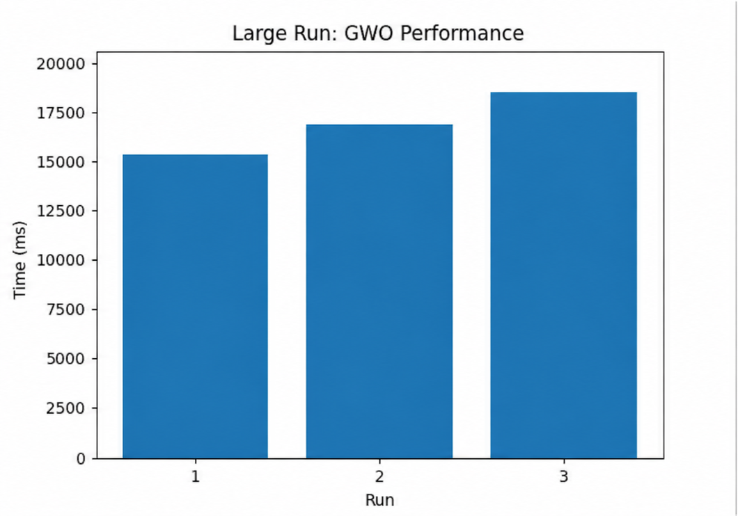
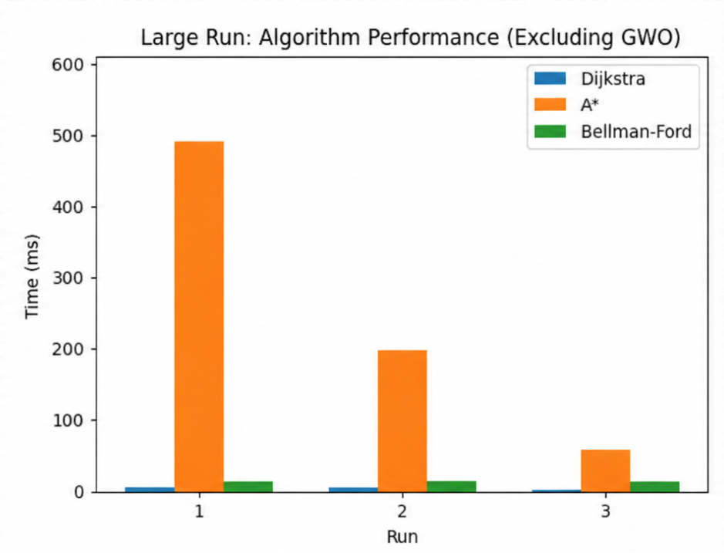
Large Size Runtime

Slide 11
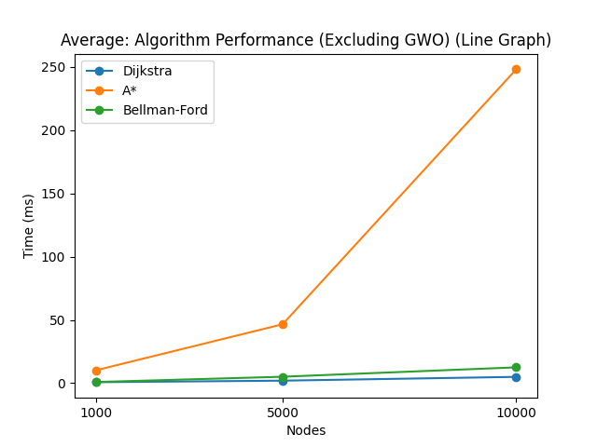
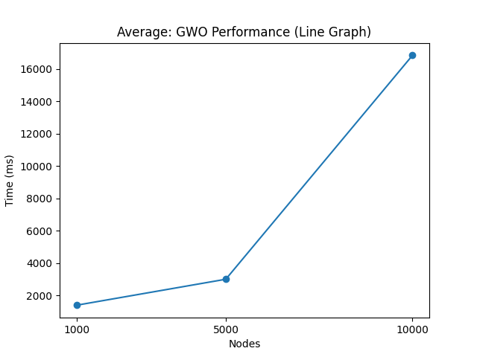
Average Runtime

Slide 12
What Went Wrong?
ACO – This algorithm was terribly inconsistent, even worse than GWO. Worked correctly 50% of the time when implemented.
OpenStreetMaps – Making a real-life implementation of this would simply be time consuming. This was overlooked as we did not think it would be too complex.

Slide 13
References:
Generative AI (ChatGPT, CoPilot, etc.)
geeksforgeeks.org – A* algorithm base code
google.com – to search for pseudocode
Lecture Notes (Dr. Radian)

Slide 14
QnA

